Slide 1
ONLINE BLOOD BANK MANAGEMENT SYSTEM
INSE- 6250 PROJECT
Submitted To: Prof. Jamal Bentahar
Name: Mohammed Faizan
(40131626)

Slide 2
CONTENTS
Introduction
Model Checking
System Model
Properties
Results
Lessons Learned
References

Slide 3


INTRODUCTION
With the advent of technology, there have been drastic advancements in the field of healthcare, where data plays an important role in this advancement. The donation of blood can save people, especially those who are cancer patients or people who have met with an accident. Thus the accuracy of the webpage information of Online Blood Bank Management System (BBMS) is of utmost importance and plays a significant role.
To design a model for navigation of pages of an Online-BBMS and verify its correctness using property specification.
Objective:

Slide 4
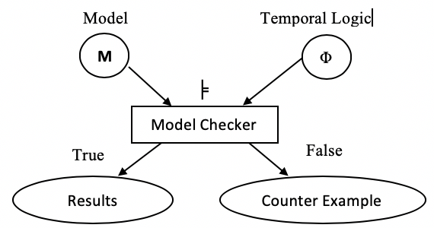
MODEL CHECKING
Model Checker Tool- NuSMV
System Behavior- Kripke structure
Computation Model- Finite State Machine (Buchi Automaton)
Property Specification- Linear Temporal Logic (LTL) and Computation Tree Logic (CTL)

Slide 5
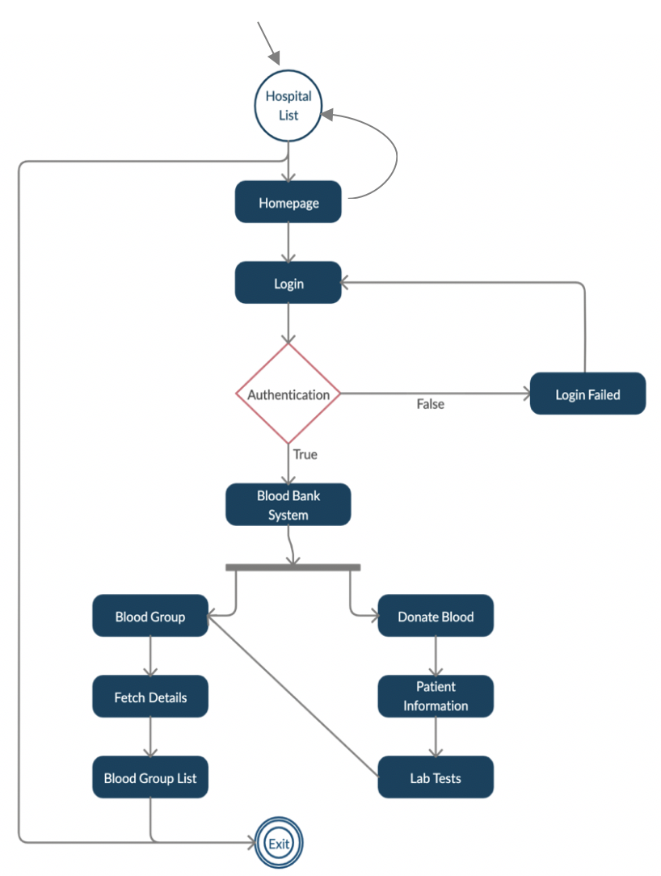
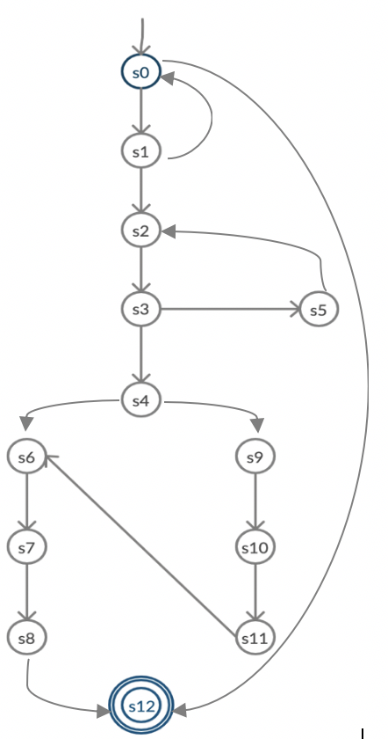
SYSTEM MODEL
Fig. (a) Flow Chart. (b) State Model of Online BBMS

Slide 6
SYSTEM MODEL
S0: Hospital List/Hub; a list or database of hospitals.
S1: Homepage; welcome page for specific hospital.
S2: Login; to be done by the user (administrator or health official of that hospital).
S3: Authentication; to check to validity of the login credentials entered.
S4: Blood Bank System; if the login credentials are correct then the main page of the system where, the user choses has option of choosing two functions (to ways to navigate).
S5: Login Failed; if the login credentials are incorrect, it prompts user to input correct details.
S6: Blood Group; this section specifies possible blood group related functionalities such as identifying availability of the blood, type of blood, stockpile, etc.
S7: Fetch Details; gets the blood group list upon user request.
S8: Blood Group List; displays the details of blood group list to the user which has all the details related to donors/patients, blood type, blood availability, etc.
S9: Donate Blood; means the user takes the blood from the donor or patient and proceeds further.
S10: Donor/Patient details; the donor name, age, and other relevant information is stored by the user.
S11: Laboratory Tests; the user then sends the blood sample for lab tests and store in hospital records. Also, this is linked to the Blood Group (state s6) as it needs access for the details of the donor and tests.
S12: Exit; exits the webpage either performing needed tasks or without performing any task.

Slide 7
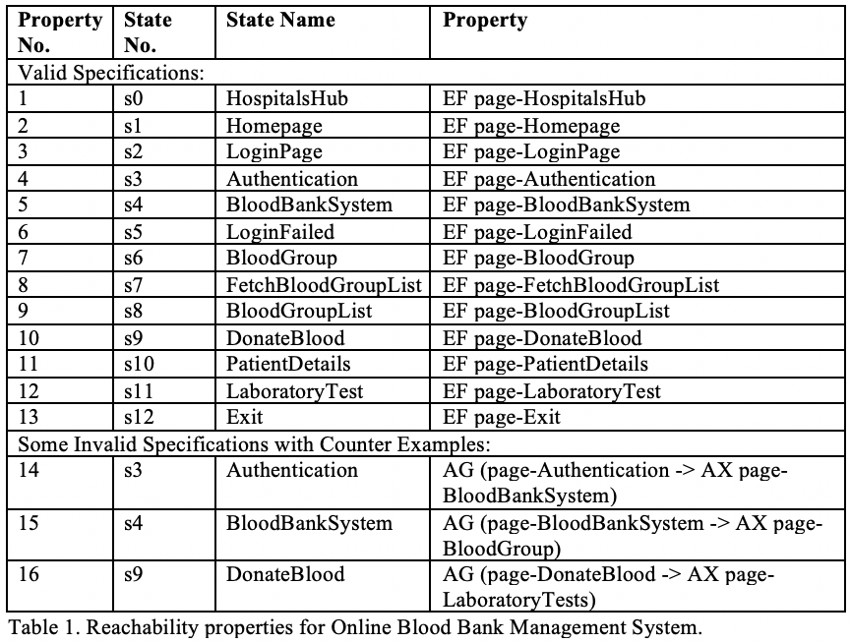
PROPERTIES
1. Reachability (CTL)- all states in the Online BBMS must be covered or reached at least once.

Slide 8
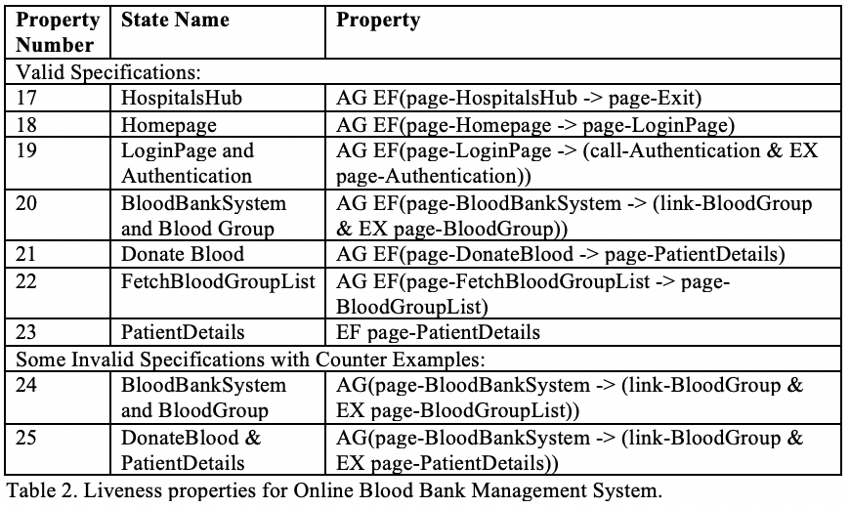
PROPERTIES
2. Liveness (CTL)- all transitions (legal transitions) in the system model must be covered at least once.

Slide 9
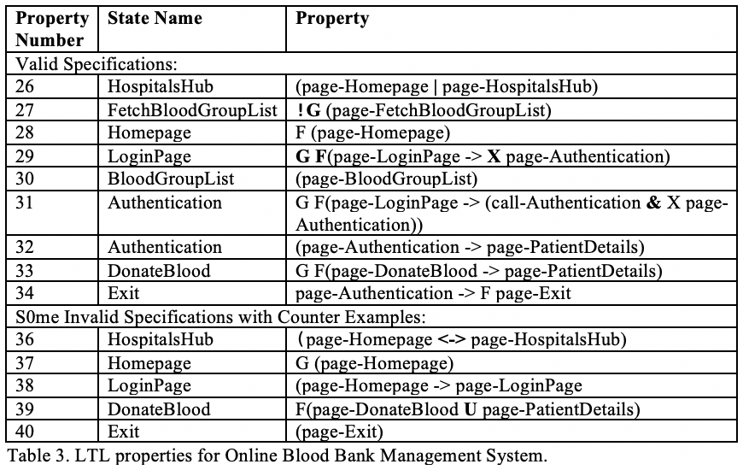
PROPERTIES
3. LTL Properties- we can also see that an LTL properties to verify our model as shown in the Table. 3

Slide 10
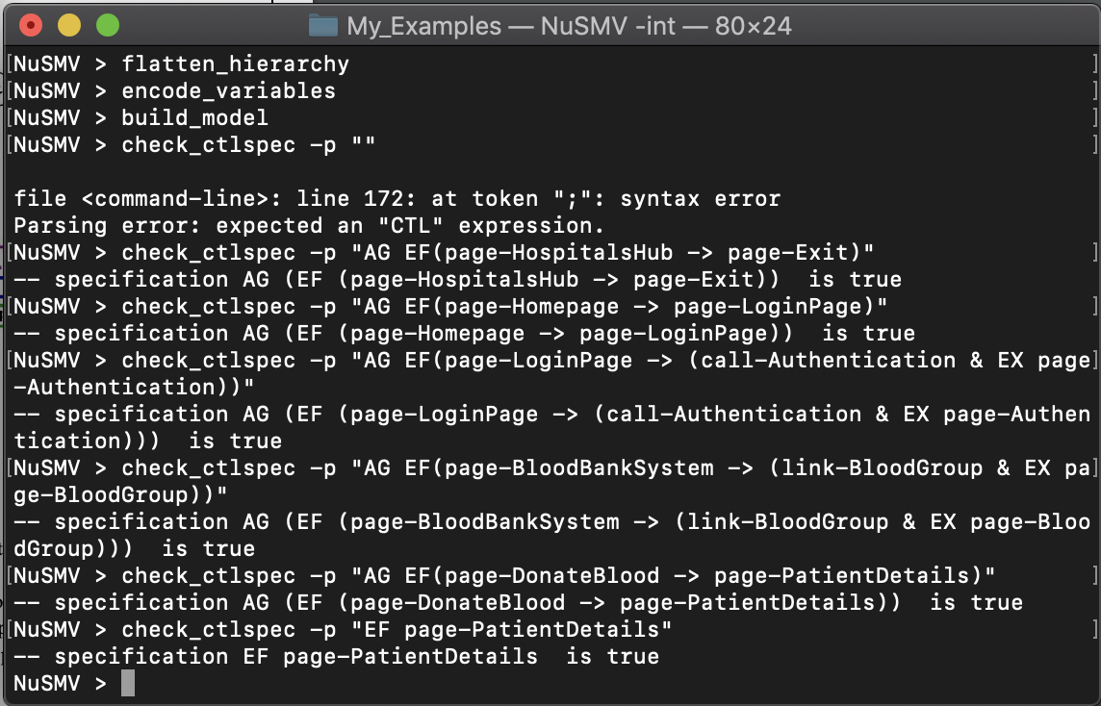
RESULTS
1. Execution of all valid specifications falling under Liveness (CTL) property

Slide 11
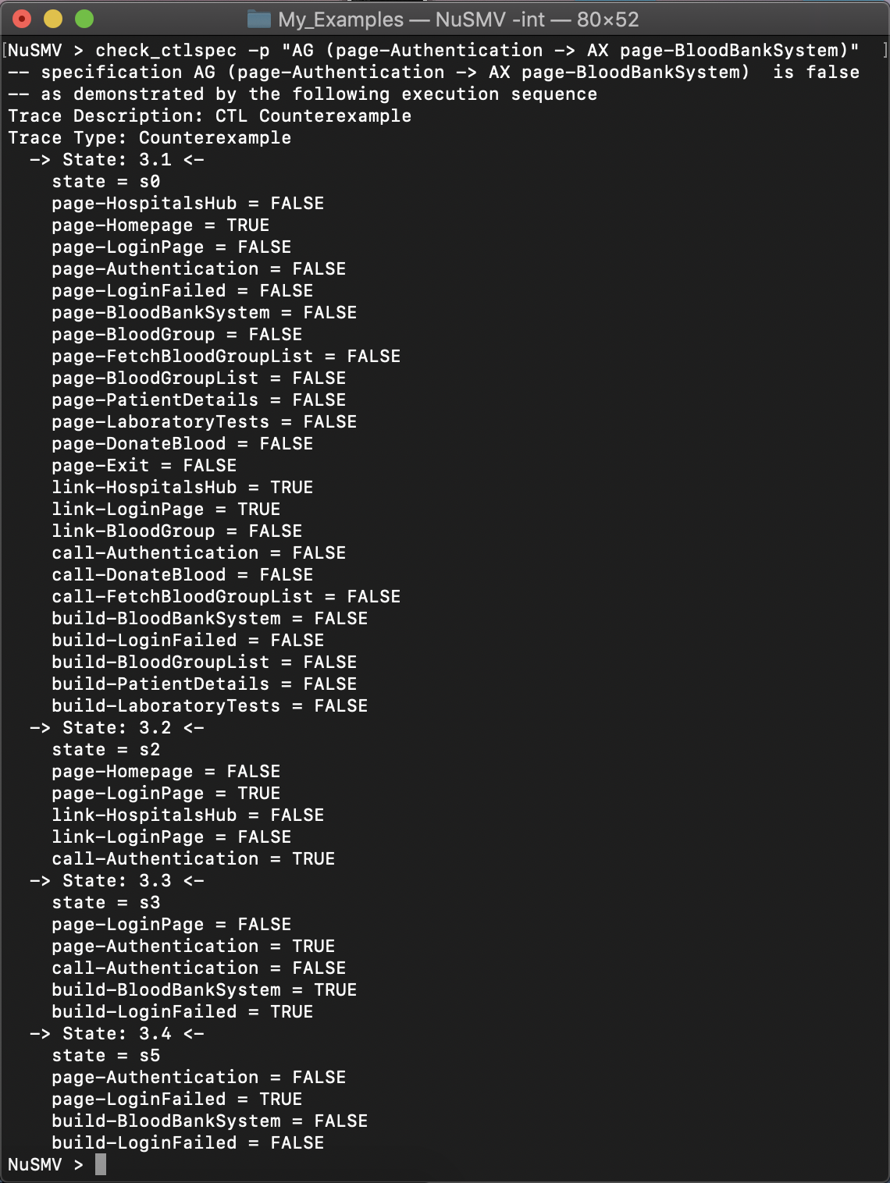
RESULTS
2. Counter Example of Reachability (CTL) property
Property No. 14; AG (page-Authentication -> AX page-BloodBankSystem)
Reason- from Authentication there are 2 transitions based on condition:
BloodBankSystem (if True)
LoginFailed (if False)

Slide 12
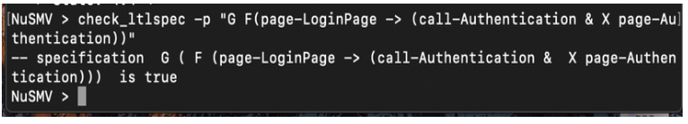
RESULTS
3. Valid Example of an LTL property
Property No. 35:
G F(page-LoginPage -> (call-Authentication & X page-Authentication))
Reason- Always from state LoginPage, if we call Authentication state, then next page will be Authentication eventually.

Slide 13
CONCLUSION
The project was aimed at modelling and verifying an Online Blood Bank Management System using NuSMV model checker tool. The model represented the general flow or navigation webpage of the system with necessary functionalities. The properties was specified and verified using CTL and LTL formulas. The final execution of the properties hinted that most of the requirements were satisfied, and counter examples were generated accordingly for the properties that did not satisfy.

Slide 14
Lessons Learned
How to analyze and understand a problem statement and convert it into a model.
How to verify a system model using properties written in LTL and CTL using auxiliary operators and temporal operators.
Understanding and specifying properties.
Determining counter examples.
NuSMV model checker tool usage.
Creating our own finite state machines using Kripke structure and Buchi automaton.

Slide 15
References
Lecture Notes from INSE 6250 – Quality Methodologies for Software.
http://nusmv.fbk.eu/
https://www.embedded.com/an-introduction-to-model-checking/
Edmund M. Clarke, Orna Grumberg, and Doron A. Peled. 2000. Model checking. MIT Press, Cambridge, MA, USA.
https://www.youtube.com/channel/UCUXDMaaobCO1He1HBiFZnPQ
http://www.inf.ed.ac.uk/teaching/courses/fv/nusmv/nusmv-startup.html

Slide 16
THANK YOU

